Slide 1

Web Automation for E-Commerce Website
Presented by: Basant Mohamed Fawzy Maryam Magdy Mahmoud

Slide 2
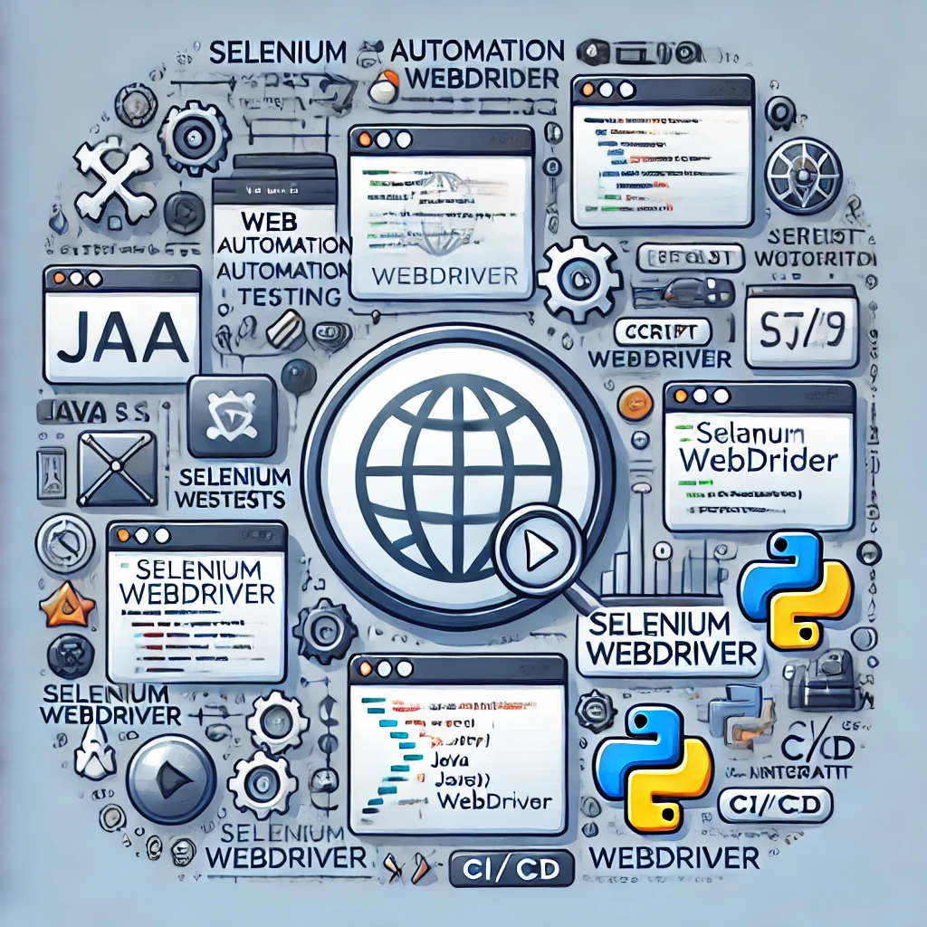
What is Web Automation Testing ?
It is the mean of using specialized tools and frameworks to automate the testing of web applications.

Slide 3
Why Web Automation?
Efficiency:
Saves time and reduces human error.
Allows faster execution of tests.
Accuracy:
Provides consistent and repeatable results.
Reduces the risk of manual testing mistakes.
Reliability:
Enhances the quality and robustness of the application.
Ensures thorough coverage of test cases.

Slide 4
When to Automate?
When to Automate
Repetitive Tests
Cross-Browser Testing
Complex Scenarios
Performance Testing
Regression Testing
When Not to Automate
Exploratory Testing
Usability Testing
Intermittent Tests
Short-Lived Projects
Initial Development Stages

Slide 5
Web Automation Common Tools
Functional Testing Tools
Selenium
Cypress
Puppeteer
Performance Testing Tools
Jmeter
Gatling
BDD Tools
Cucumber
SpecFlow
Integration Testing Tools
Robot Framework
TestNG
Design Patterns
Page Object Model (POM)
IDEs
Intellji
Eclipse
Visual Studio code

Slide 6
Why Selenium
Why Selenium?
Supports multiple browsers and languages, extensive community support, powerful extensions.
Why TestNG?
Advanced features for running tests in parallel, grouping tests, and generating detailed reports.
Why Maven?
Manages project dependencies and builds, streamlining setup and execution of tests
Why IntelliJ ?
Robust development environment with integrated tools for debugging, testing, and managing projects.

Slide 7
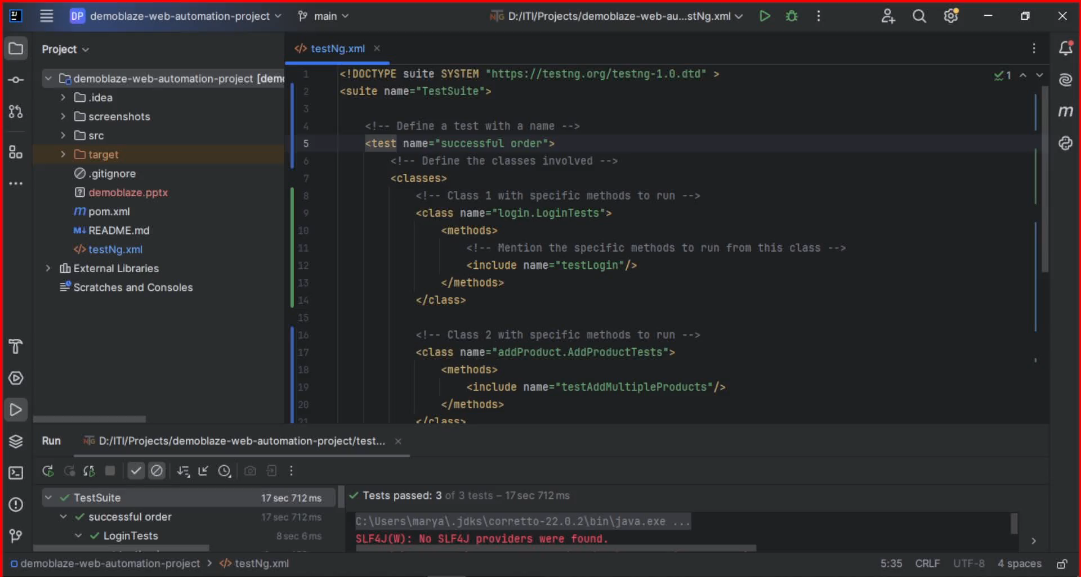
Video Demo

Slide 8
Thank You

